Slide 1
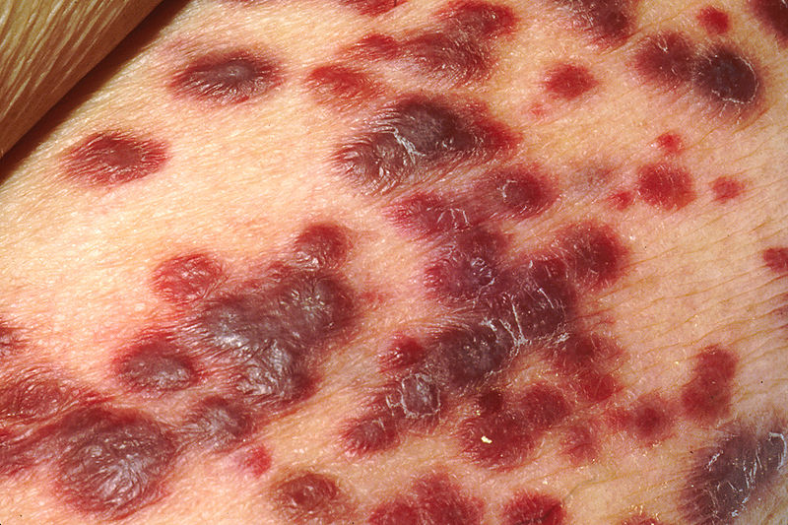
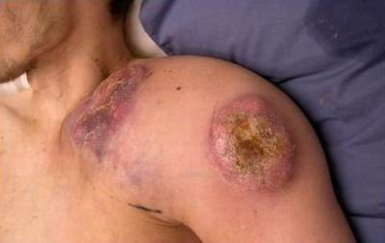
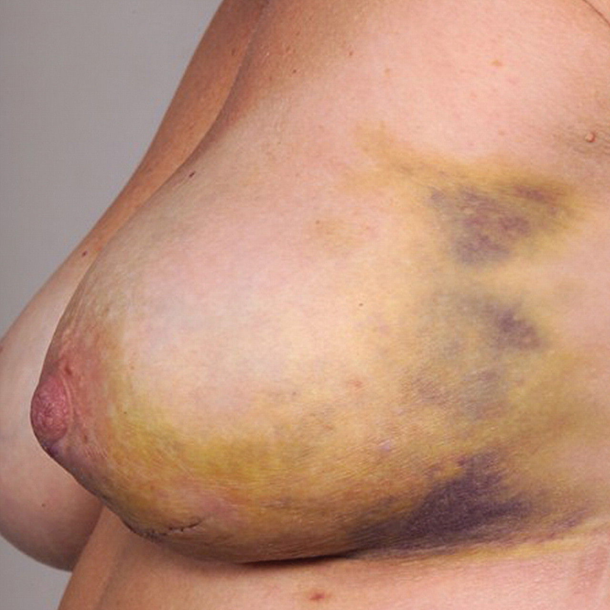
Various Outcomes of Advanced AIDS
Kaposi's Sarcoma
Non-Hodgkin's Lymphoma

Slide 2
Wear a Kaposi’s Shirt
Kaposi's Sarcoma lesion collection- this t-shirt has different presentations of Kaposi’s.
Touch the pyramid, look for object in your viewer, accept, and wear.

