Slide 1
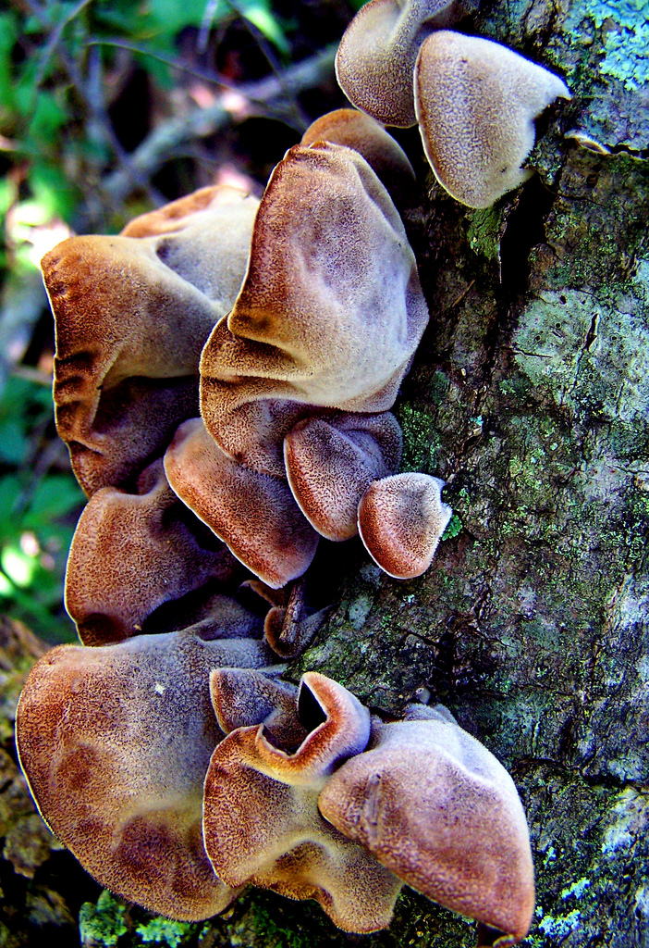
Welcome to the GENITAL WART Variety Garden
You are probably wondering what the tree bark with the parasitic fungus on the right has to do with GENITAL WARTS?
Genital Warts have a similar appearance as you can appreciate on the mushrooms (penises) and flowers (anus). Although, similar in appearance, they are quite different, GENITAL WARTS are caused by Human Papilloma Virus (HPV) not a fungus.
The MALE genital wart incidences presented here range from mild to serious. The incidence in the anus is the same for male and females. Anal HPV warts can be easily confused with hemorrhoid tags.

Slide 2
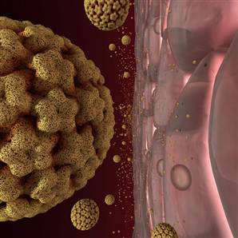
What is Human Papilloma Virus?
About 30 types of Human Papilloma Virus (HPV) are spread through sexual contact and can infect the genital area.
Other names for HPV:
  anogenital warts
  genital warts
  venereal warts
HPV infects 3 to 28% of the population in the United States. 6 million cases reported yearly.
There are 100 harmless HPV types, these cause:
  Plantar warts
  Common hand wart

Slide 3
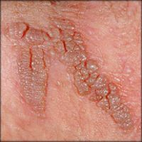
Human Papilloma Virus Symptoms
General Information for Males and Females
Symptoms may occur several weeks to months after being exposed to Human Papilloma Virus (HPV) and include:
Itching or burning around the sex organs
Painless growths in either sex usually on damp or moist surfaces of the body beginning as tiny, soft pink or red spots
Spots develop into small, white/yellow/gray bumpy warts on the sex organs and anus
Warts can grow quickly into irregularly shaped cauliflower-like masses

Slide 4
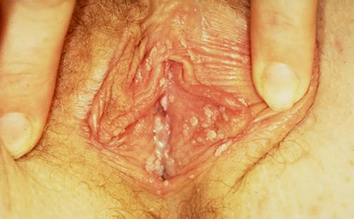
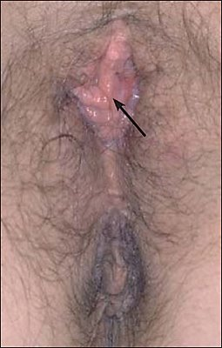
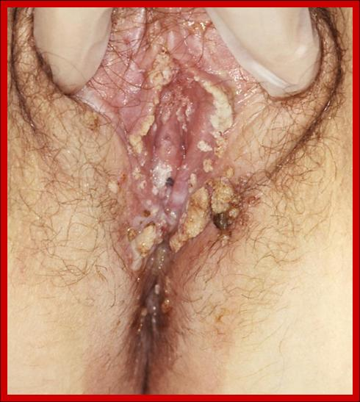
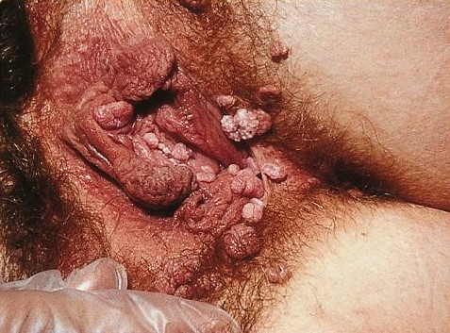
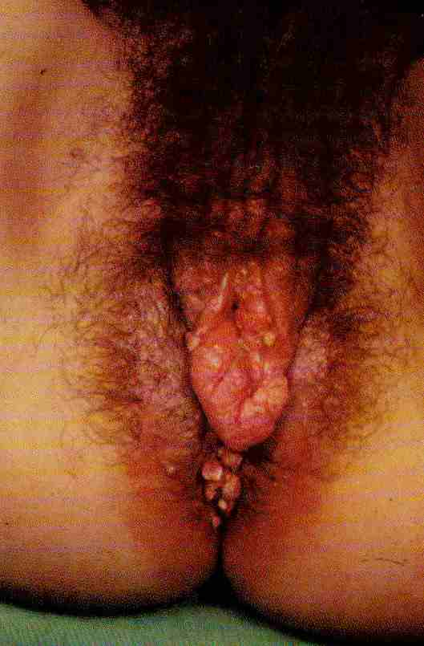
External Female Genitalia
HPV
From Mild to Severe

Slide 5
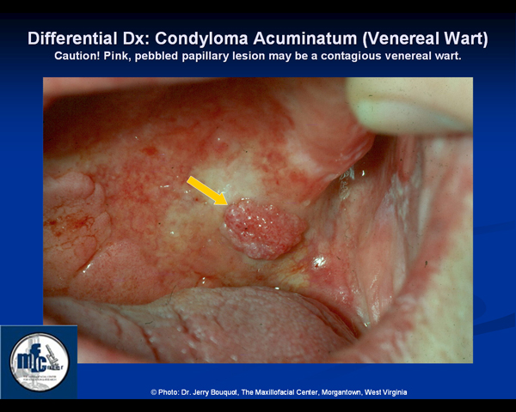
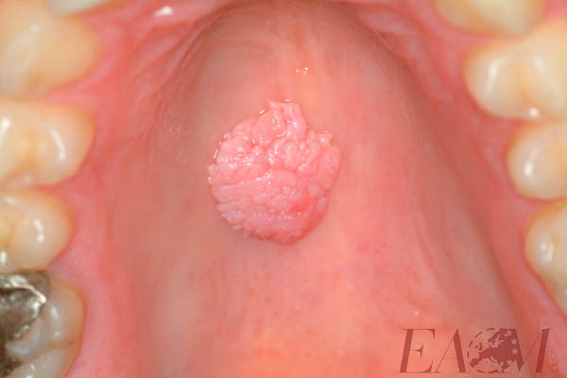
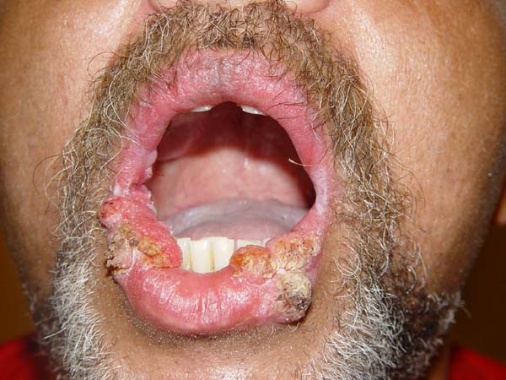
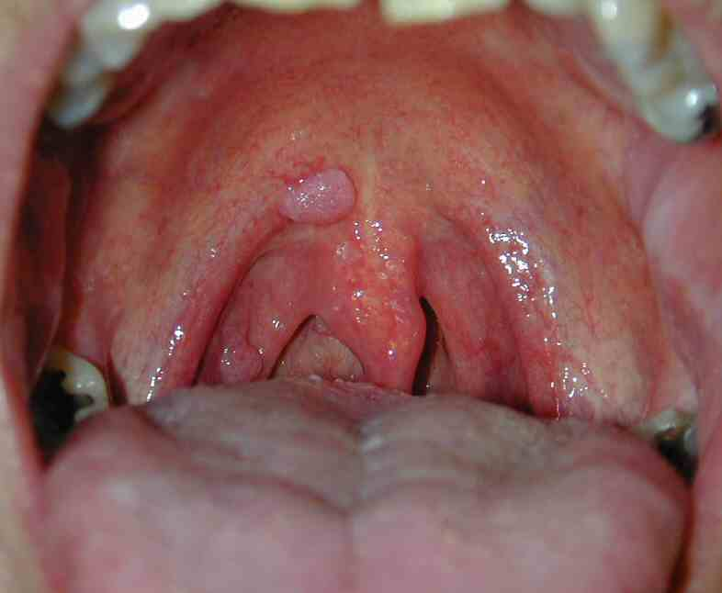
Oral HPV secondary from oral sex
with an infected partner

Slide 6
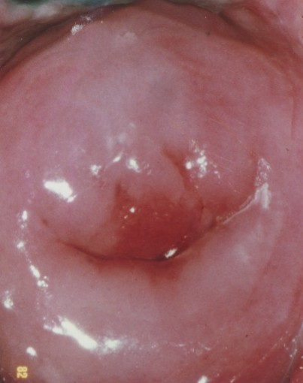
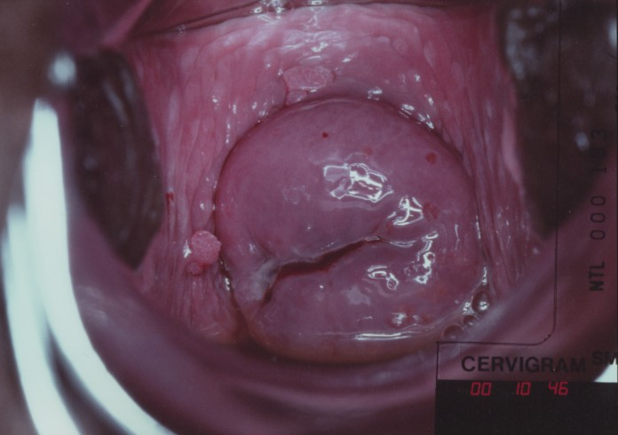
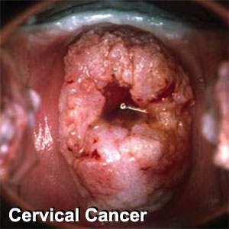
Males get HPV warts EXTERNALLY (penis & anus) and ORAL MUCOSA (women too). HOWEVER, in women HPV infestation extends to the vaginal canal and cervix. HPV can develop dysplasia in the cervix- the outcome
cervical cancer.
Walk in this simulation of the vaginal canal, at the end the cervix has
moderate to severe dysplasia.

Slide 7

If you are getting involved in use protection…
Below various barrier forms of prophylaxis…

